Slide 1
Using Computer Vision Methods to Predict Building Density Measurements Using Geospatial Image Classification
Evan Carraway & Dan Stevens

Slide 2
Introduction
Geographic Information Systems
Capturing, storing, manipulating, and analyzing spatial or geographic data
Google Maps, location tracking, etc…

Slide 3
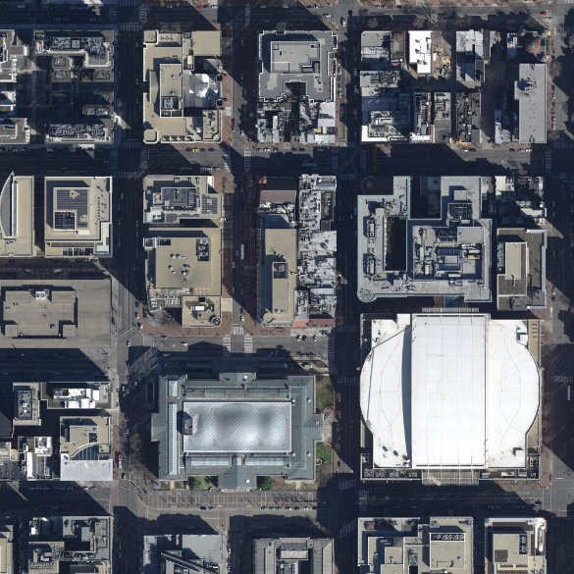
Problem
How would you classify this image?
Given this image and historic images what could you explain?
Can you train a model to differentiate between this urban block and a forested area?
How can we use the building density to accomplish this?

Slide 4
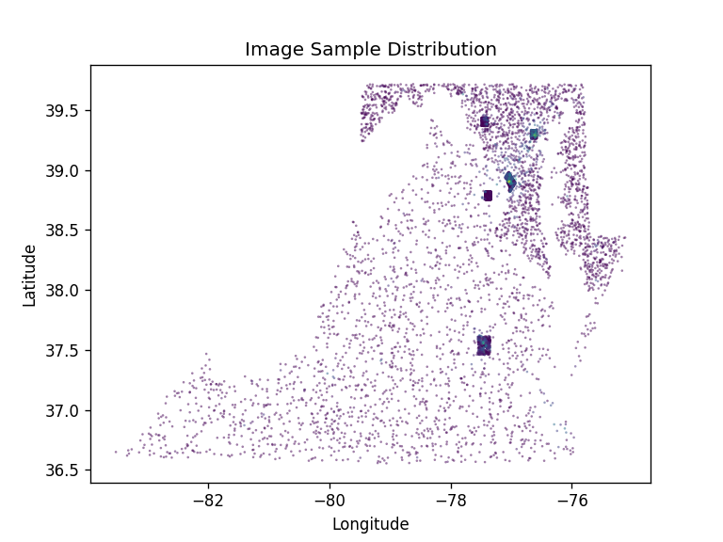
Problem (cont.)
Limited the scope of training/testing area to just Virginia, Maryland, and the District of Columbia
Defined regions split by geographic coordinates in order to ensure train/test set is balanced
Over sampled urban areas to achieve better distribution of densities

Slide 5
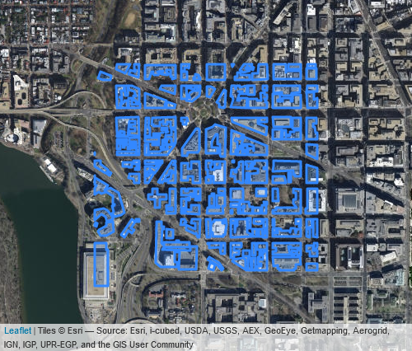
Data Prep
Select, clip and calculate area of building polygons at a random location
Divide by total area to label image with building density
Augment images through flipping and rotation
Resize and add/remove noise depending on model

Slide 6
Methods Selected
Multilayer Perceptron
Good for classification problems
Can easily tweak parameters to have n neurons
Convolutional Neural Network
Can be used for classification problems
Good at analyzing images

Slide 7
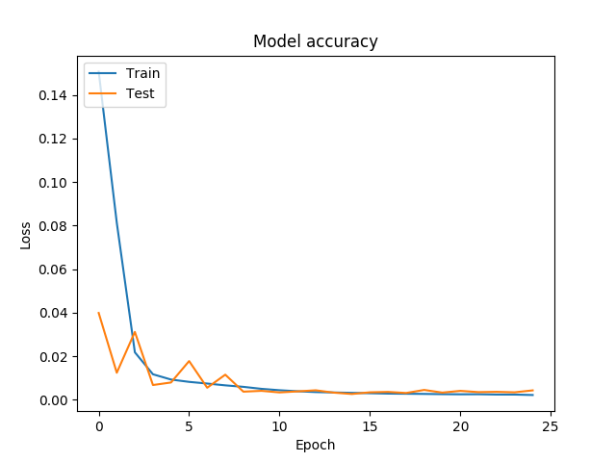
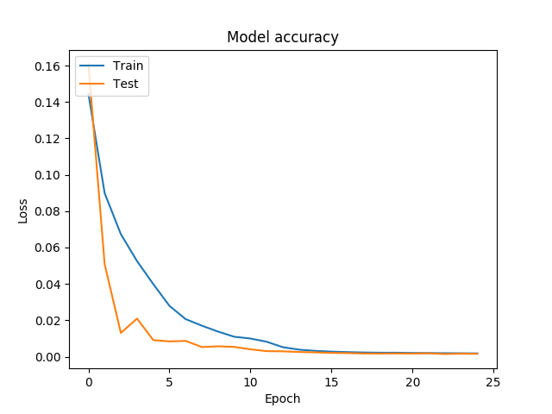
Methods (Cont.)
MLP
MSE - 0.00272
CNN
MSE – 0.00147

Slide 8
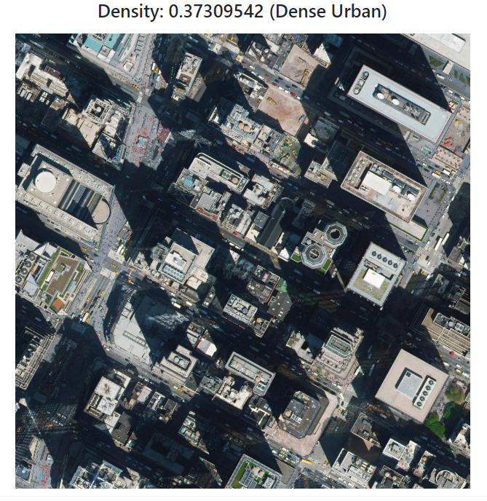
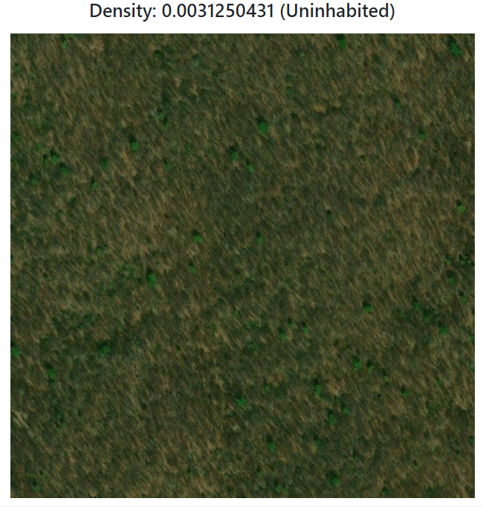
Application

Slide 9
Applying Algorithm to Examples
Web App Demonstration

